Slide 1
Info-6079 Security Application
Working with Files
Number Conversions

Slide 2
Lecture will cover
What is a file
File path
Files in Python
Interacting with file(s)
Open() Function
Converting decimal to binary and back

Slide 3
What is a file?
In pure terms:
A set of bytes used to store data.
Files can store data, information, settings, or commands used with a computer program

Slide 4
File Paths
When access a file in OS, we need to access it via file path.
File paths are the locations of files in a strings format.

Slide 5
3 major parts of a file are:
Folder path: the file folder location on a file system. Sub folders are separated by slashes. Forward slash (/) for Unix and backslash(\) for windows
File Name: the name of the file
Extension: starting with period(.) used to indicate the file type. Example .py

Slide 6
Files in Python
Files follow into two categorize.
Text
binary
Text files are structured as a sequence of lines. Each line include sequence of characters.
Each line is terminated with special character called End of Line (EOL). Most common are comma (,) and newline.

Slide 7
Files in Python
Binary file: can only be processed by application that know or understand file’s structure.
These files must be applications that can read and interpret binary

Slide 8
Open() Function
To read or write to a file in Python, we use open() function
We give it 2 arguments: filename and mode
Filename is the name of the file, includes path if not in the same folder
Mode: tells the interpreter and developer how are we going to interact with the file
Open() returns a file object a
objFile = (“filename”, “mode”)

Slide 9
Mode
‘r’ – Read-only; default option
‘w’ – Write-only; creates a new file
Erases file if it exists in the path
‘x’ – Write-only; creates a new file
Fails if the file exists in the path
‘a’ – Appends to existing file; creates a file if it does not exist
‘r+’ – Read and Write mode

Slide 10
Mode – Addons
‘t’ is used to deal with text files
Is default if not specified
Automatically decodes bytes from bytes to Unicode
Example: ‘rt’ to read and ‘wt’ for write to text files
‘b’ is used to deal with binary files
‘rb’ for reading to byte files
‘wb’ for writing to byte files

Slide 11
What is a binary file?
A file that stores data in binary format
It readable by the computer but not humans, at least not easily.
Example:
Executables,
Databases usually save their in data in binary files
applications use binary to store generated data,
media files
Can find other examples at: https://simplicable.com/new/binary-file

Slide 12
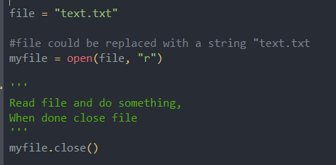
How to use open() function
First step is to connection to the file and save the connection to an object.
Option 1: object_name = open(path/file, mode)
This would require you to close the connection with, object_name.close()

Slide 13
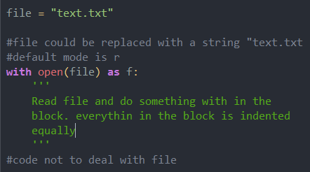
How to use open() function
Option 2: with open(path/file, mode) as objFile
As you see you don’t need to close connection, it does it for you
This is the recommended way

Slide 14
Open() methods:
While there is a connection to the file we could use several methods:
read([size]) returns data from file as a string.
Will read until end of file in size not set
readline([size]) returns list of lines
Will save lines in a list
***size argument states how many bytes to read

Slide 15
Open() methods:
write(str)
Writes the str argument to file
writeline(strings)
Writes strings arguments to the file
Close()
Close handler
Flush()
Flush the interbak I/O buffer to disk

Slide 16
Open() methods:
Seek(pos)
Move to indicated file position
pos is an integer that represents the byte in file
Tell()
Returns current file position as integer
Closed()
Returns True if file is closed

Slide 17
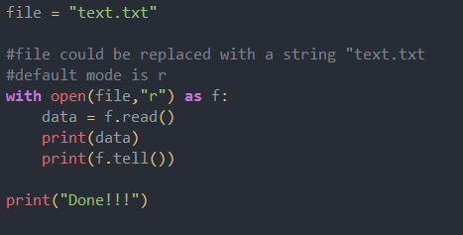
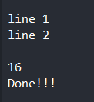
Example:
Code:
Output :

Slide 18
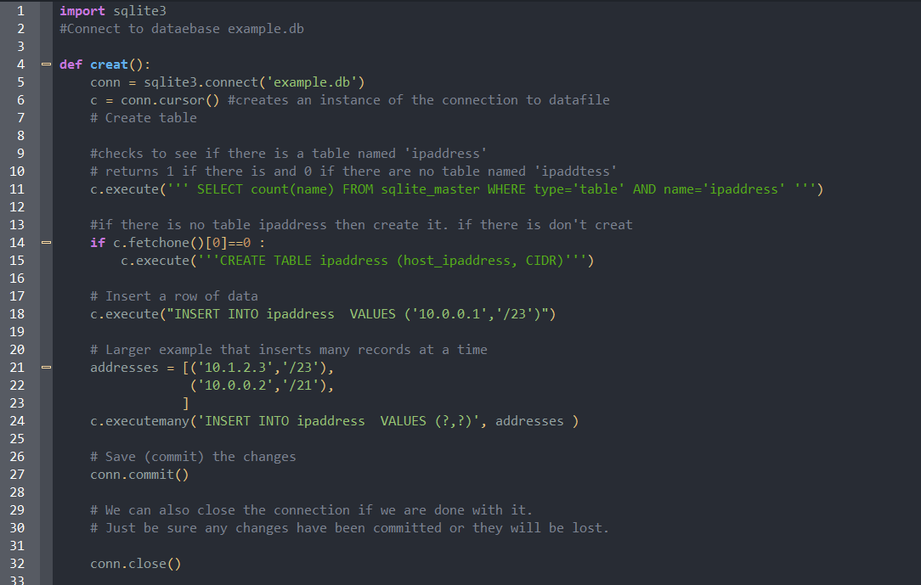
Notes:
We Import sqllite
Make a connection to database file

Slide 19
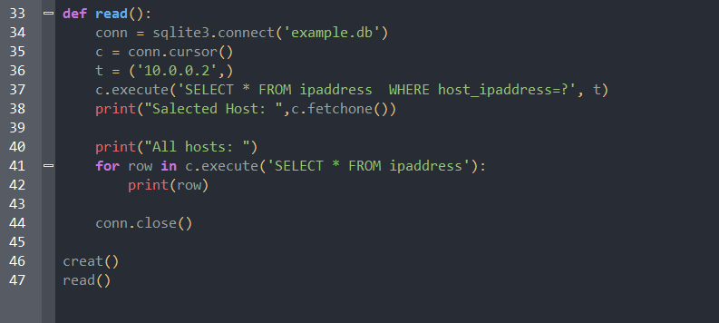

Slide 20
Converting from bin to decimal

Slide 21
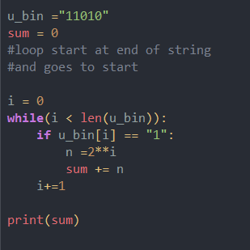
Ways to convert to bin to decimal
We have u_bin that holds “11010”
It does not matter if it’s from user, file, or hard coded
One way to convert is to loop through the string:
Is this the easiest way?
Notes:
Is this the best way to do this

Slide 22
Int() option

Slide 23
Int() basics
Int() function takes 2 arguments
Syntax is int(string, base)
string
Base, by default is base 10 or decimal.
If you don’t put anything int() uses base 10
So far in course we used based 10
Examples to get 2
int(“2”,10)
Int(“2”)

Slide 24
Init() basics
Yes!!!! Put int(2) or int(2.2) will also work to get 2.
This only works if you don’t put a base in
This won’t work
int(“2.2”,10)
Int(2.2, 10)
What would happen if we put base 2 for binary and put a binary number as a string?

Slide 25
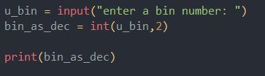

Code:
Output:

Slide 26
Revert decimal to bin
u_bin = bin(200)
Saves string that 0b11001000
The 0b (zero b) tells the system that we are dealing with a binary
To print with out 0b we could do:
print((u_bin[2:])

Slide 27
Hex conversions
Hex is base 16
Used in IPv6 and RGB colors
Ex we have hex number: 5fb2
Int(“5fb2”,16) will output 24498
hex(24498) will output 0x5fb2
Ox (zero and x) tells computer the next letters are hex
hexn = hex(24498)
print((hexn[2:]) will output 5fb2

Slide 28
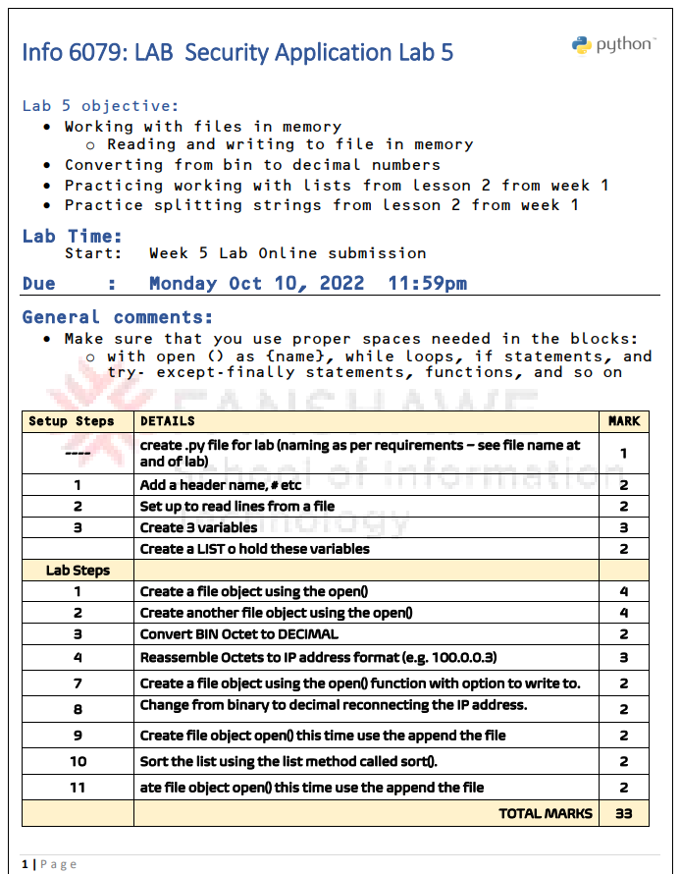
LAB 05
Go through lab 5

